Slide 1
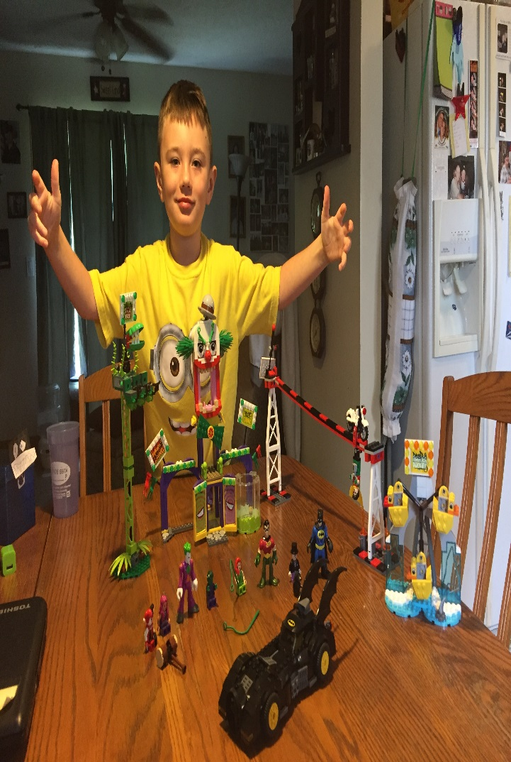
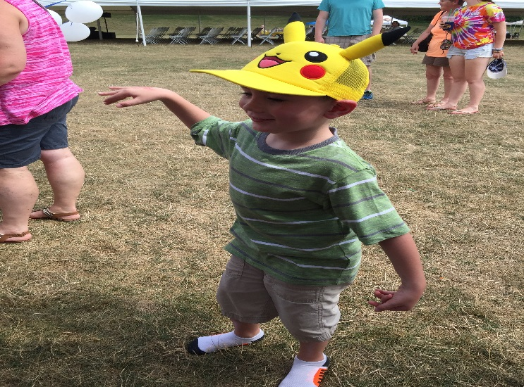
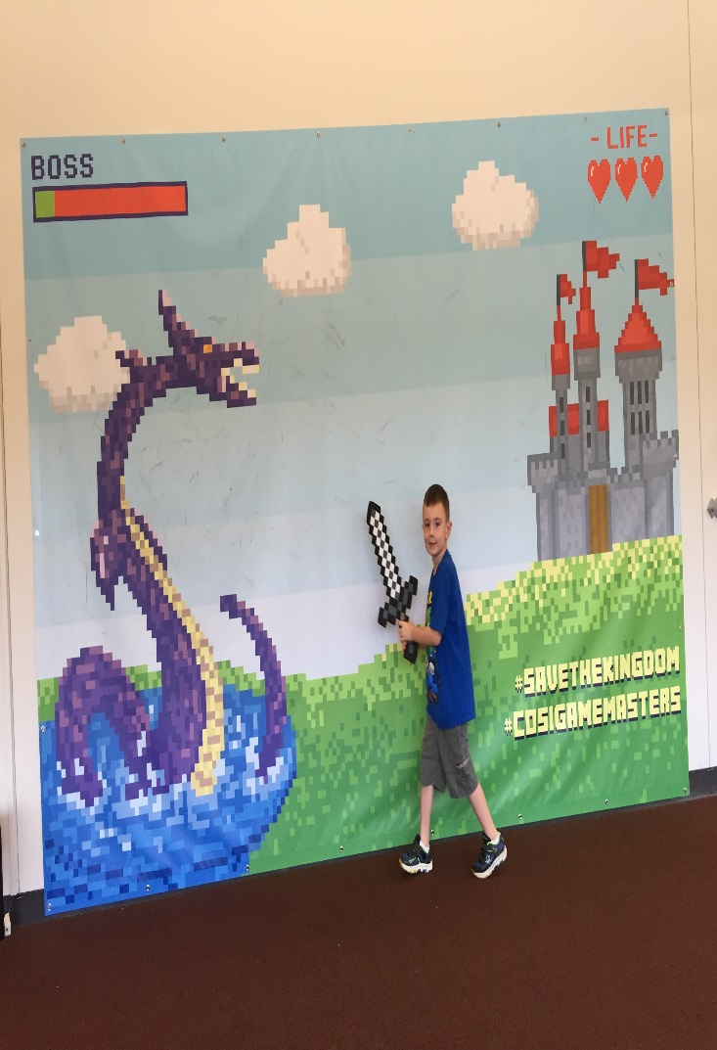
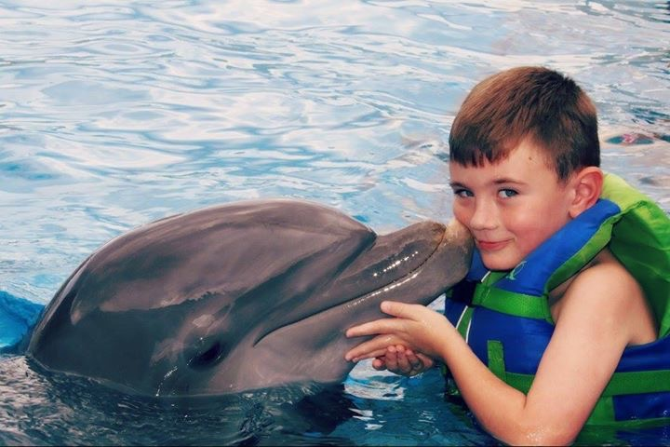
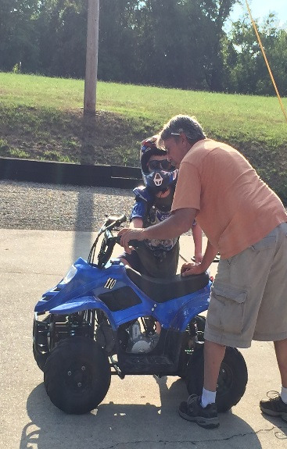
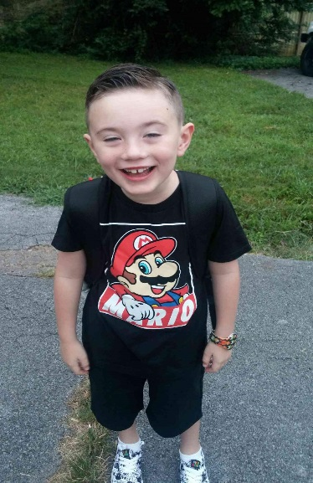
SPARCC INFOhio Users Meeting
September 26, 2016

Slide 2
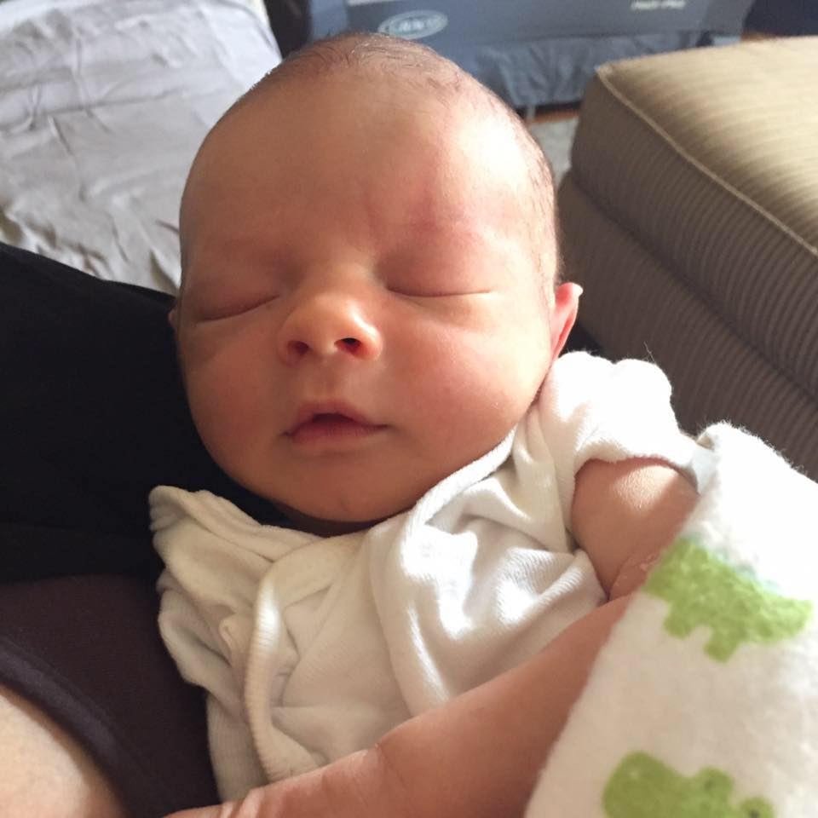
Our Newest Addition!
Ronald James (RJ) Selak
Born Sept 12th – 19 ½ inches / 7.4 lbs

Slide 3
Welcome!
Kathy Eddy – Alliance/Northside
Cynthia Brunner/Leanne Barton/Jean Reisdorf/Tammy Geraghty – Canton City Elementary Schools
Heidi Miller – Marlington/MS
Sarah-Jayne Studer – Massillon/High School
Tina Braman – Northwest/High School
Christine Wenning – Perry/HS
Adena Beach – Plain/Middlebranch & Avondale
Jackie Dunn – Southeast/HS
Lori Thomson – Streetsboro/HS
Jodi Ruehling – Tuslaw/MS
Shelly Swierz – St Louis
Marlington – Hiring
Canton Local – MS ??

Slide 4
SPARCC INFOhio Billing
Member Districts
From $1.00 to $1.15 per student
$400 to $450 per building
Non-Member Districts
From $1.35 to $1.60 per student
From $440 to $475 per building

Slide 5
WorkFlows Upgrade &MobileCirc
WorkFlows 3.5.1.1 Update:
Notify me by email that update has been completed for your district
6 Districts confirmed updated: CCS/LSCS/MNLS/SVLS/SBCS/TSLS
WorkFlows Upgrade was required to be complete by Sept 9th, 2016
Some issues experienced with Update
Feature: Modify size of toolbar text! Desktop - Preferences
MobileCirc Enhancements:
Kiosk mode – can now scan either the User barcode number or the user Alt ID number for User ID.
IOS app – new version available for download from the App store
Now scans both Codabar and Code 3 of 9 barcodes.

Slide 6
New BookFlix Titles
New BookFlix titles also available in ISearch
Me...Jane/ Jane Goodall
Who Says Women Can't Be Doctors: The Story of Elizabeth Blackwell/A Day with Doctors
Each Kindness/Kindness and Generosity: It Starts with Me
The Star-Spangled Banner/The American Flag
Don't Let the Pigeon Drive the Bus/Car Safety (pair also available in Spanish)

Slide 7
Vendor Loads / Cherwell sparcc_infohio@email.sparcc.org
Please use Cherwell for all Vendor Loads except Follett
Subject: Building / Vendor Name / “Marc Records” or “Vendor Load”
Attach the actual file – mdb, .001
Special Instructions? Include them (no barcodes etc..)
Available! Cherwell User Portal!
- Allows you to see your tickets that you have active
- Allows you to open / reopen / close tickets
- Uses your Active Directory username / password (check with tech)
w.sparcc.org
www.sparcc.org

Slide 8
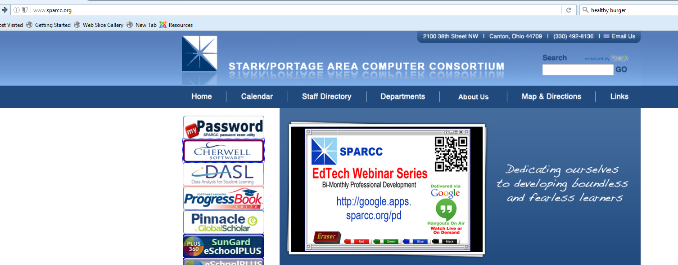

Slide 9
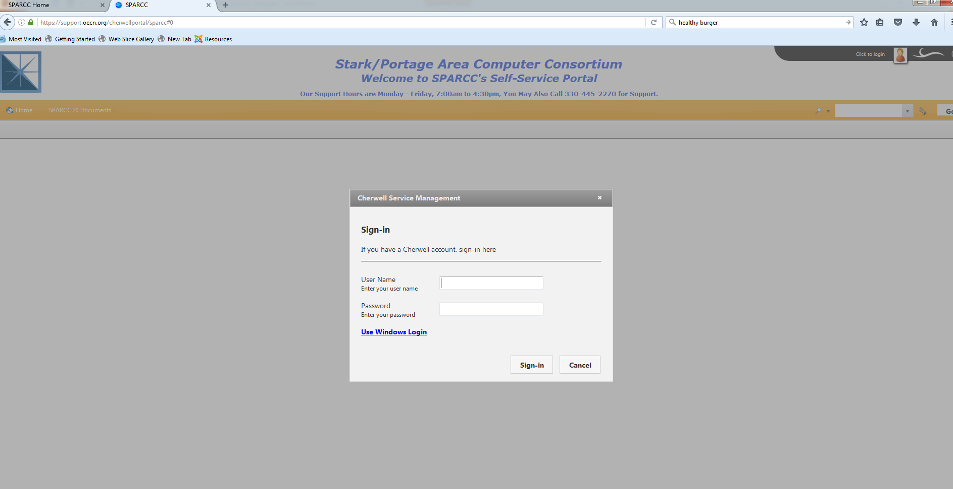

Slide 10
Updates
INFOhio Advocacy - Christina
SPARCC Librarians ListServ
sparcc_libs@email.sparcc.org
INFOhio User Council Update
Amy, Mindy, and Sarah!

Slide 11
Google Forms/Sheets for Library Attendance and Usage Statistics Reporting
Google Forms/Sheets by:
Laura Henning, Media Specialist
Trumbull Career and Technical Center
laura.henning@tctchome.com
(330) 847-0503 x1410
Presented by:
Autumn Roper,
Coordinator of Library Application Software, NEOMIN

Slide 12
Google Forms/Sheets for Library Attendance and Usage Statistics Reporting
Google Form
Students sign in/out via computer/iPad stations
Form submits attendance data to Google sheet
Google Sheet
Shared to all teachers
Form displays in reverse sort order (newest at top)
Shows usage statistics (summary of responses in graph format)

Slide 13
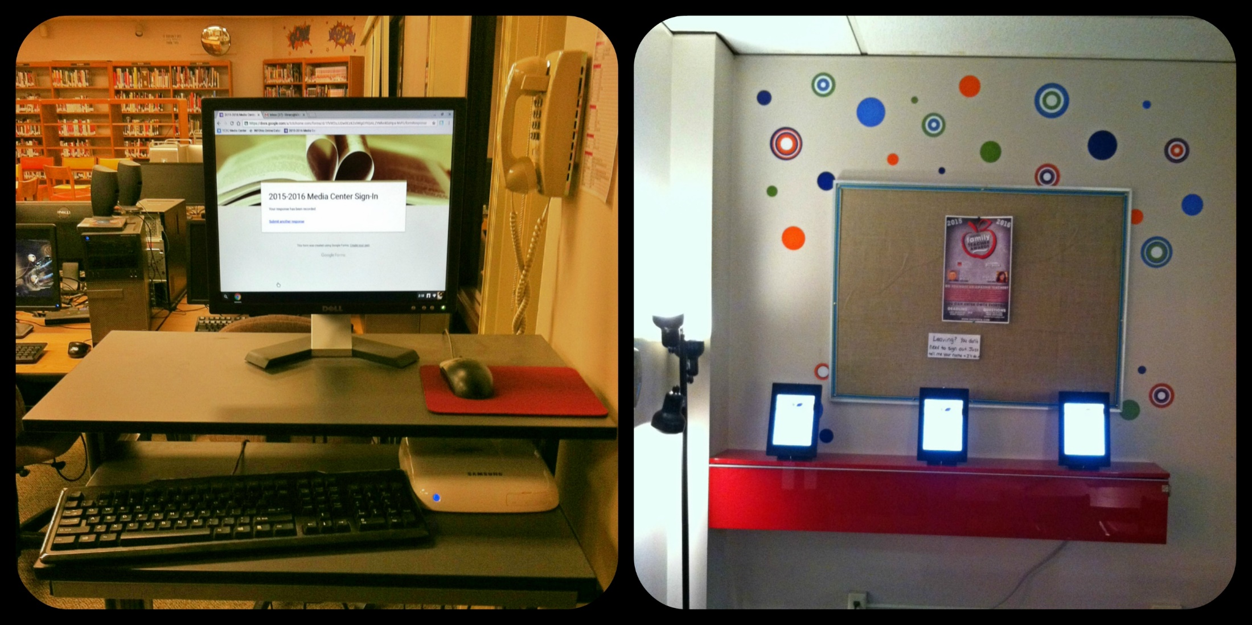
TCTC Student Sign In/Out Stations

Slide 14
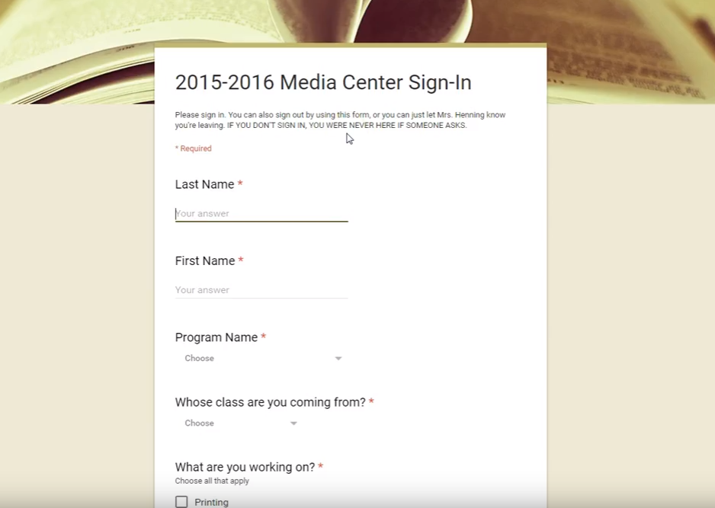
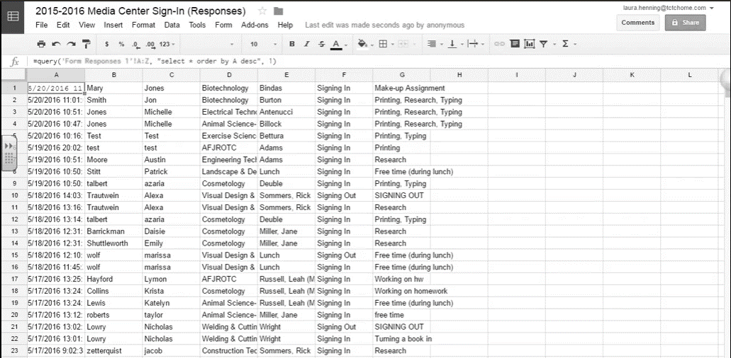
Overview: How does it work?
Google Form
Saves to
Google Sheet
Viewable by all teachers!
Via iPad, Phone, or Computer

Slide 15
Google Forms/Sheets for Library Attendance and Usage Statistics Reporting
Laura created an Overview Video using Screencast: https://drive.google.com/a/neomin.org/file/d/0B-gBeZJANbftTmd4NlI1Y0xhbzQ/view (8 min)
Link to formula for reverse sorting: https://productforums.google.com/forum/#!topic/docs/MUNxz64Lo0Q
Usage Statistics: Google Sheets Menu > Form > Show Summary of Responses

Slide 16
Google Forms/Sheets for Library Attendance and Usage Statistics Reporting
Google Forms/Sheets by:
Laura Henning, Media Specialist
Trumbull Career and Technical Center
laura.henning@tctchome.com
(330) 847-0503 x1410
Presented by:
Autumn Roper,
Coordinator of Library Application Software, NEOMIN

Slide 17
www.infohio.org/students
LOCAL
Notes:
ISearch is a discovery tool that allows students and teachers to search their school library catalog and almost all INFOhio digital tools, including the videos in the Digital Video Collection and INFOhio eBooks, with one click. (ISearch does not search Early World of Learning, Ancestry, and the Spanish and French Encyclopedias.)

Slide 18
ISearch helps educators
meet the needs of individual students.
Notes:
With one search, educators can find magazine articles written at different levels to better meet students where they are. They also find videos for students who prefer to get information visually, along with a host of ebooks and print books.

Slide 19
ISearch supports
college and career readiness.
Notes:
It is very similar to the discovery tools used at most Ohio college and university libraries and many public libraries.
And this fall, ISearch is becoming even more like systems used in colleges. INFOhio libraries—the ones that use INFOhio software, CAT and CAT Jr.—will be able to search their catalogs through ISearch as well, which is exactly the way college libraries are organized. Many of the more than 2,300 INFOhio school libraries in Ohio already are able to search their library resources through ISearch. We’re on track to move all INFOhio libraries into ISearch by September 30.
But let me make it clear, all students in Ohio can use ISearch, not just INFOhio libraries. All they have to do is use the search box at the top of our INFOhio resource pages.

Slide 20
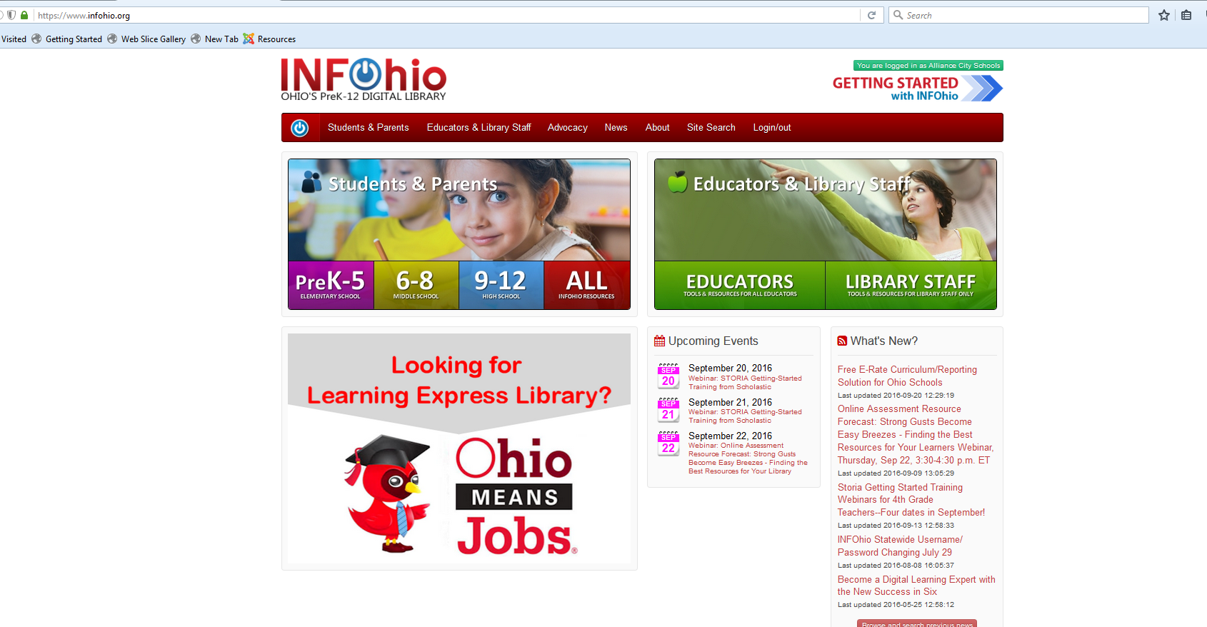
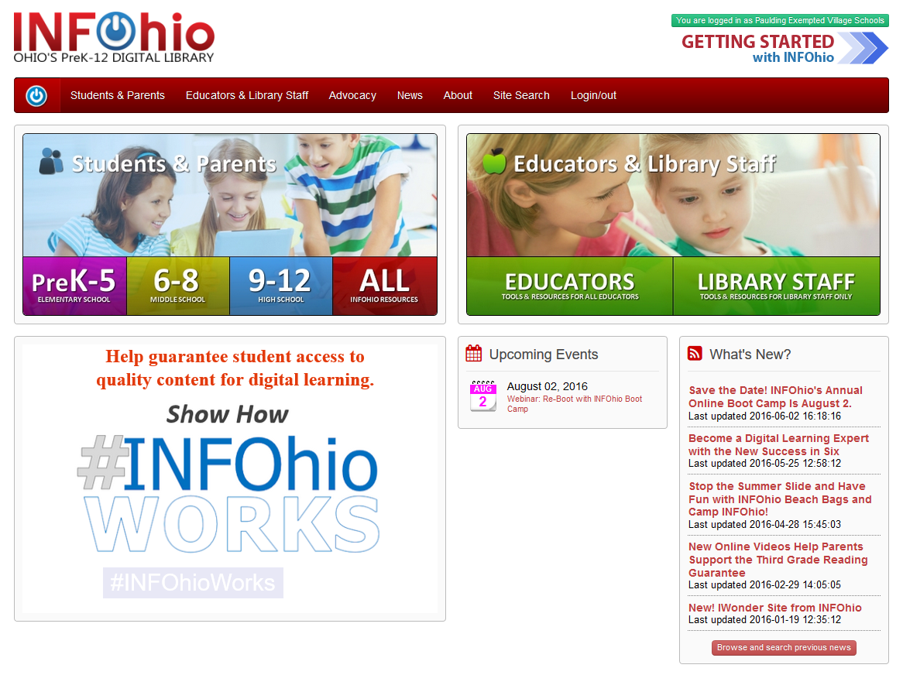
Notes:
Your own version of ISearch that includes your school library catalog along with INFOhio resources is live now! To access it, visit the INFOhio website and be sure that you are logged in with your school’s INFOhio username and password. Once you are logged in, click any of the student resource buttons

Slide 21
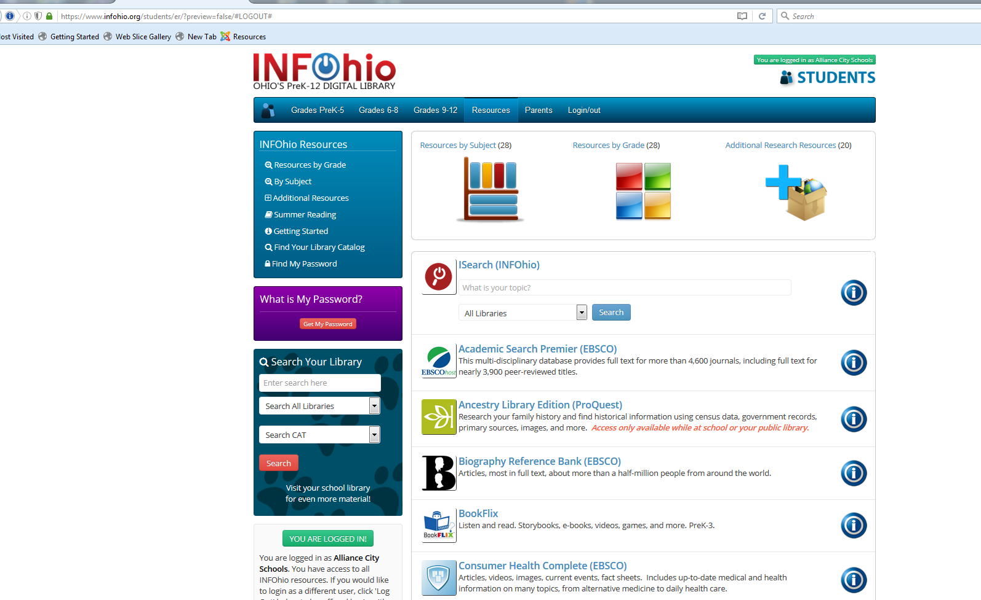
Notes:
You should see an ISearch search box with an “All Libraries” drop-down that will let you choose which library catalog you want to include. I’m going to do a search for “stem cells” and leave it set to search all libraries.

Slide 22
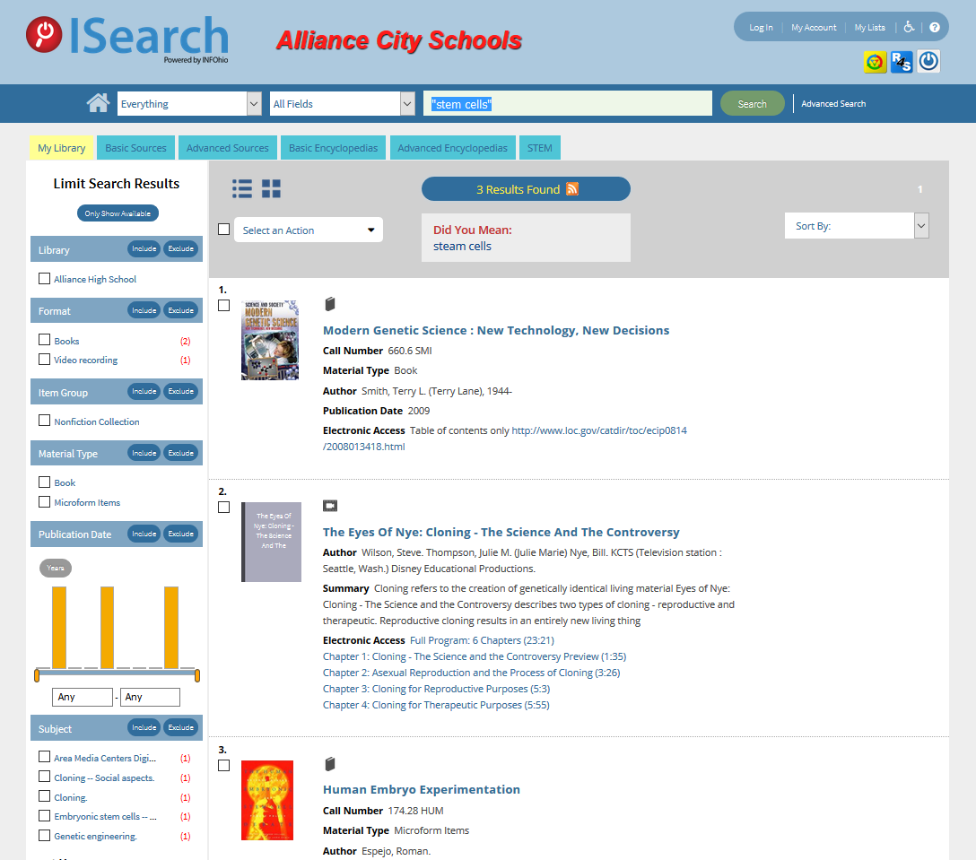
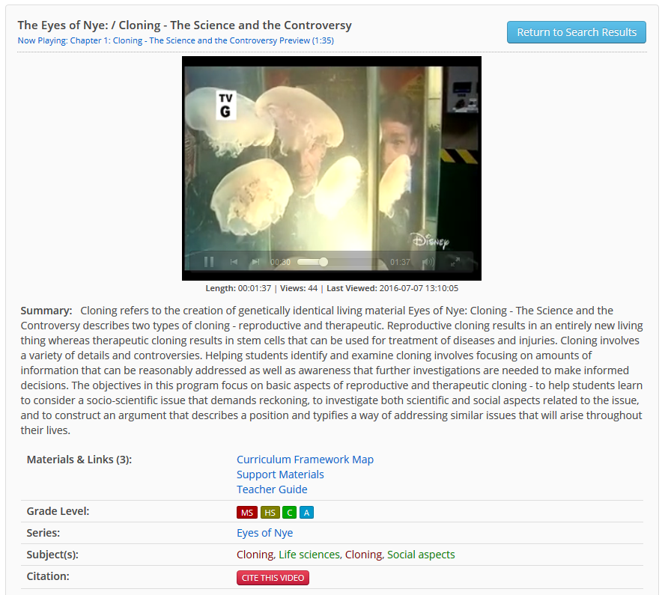
Notes:
Here I am on the My Library tab. If you’ve used ISearch before, this might look a little different. This summer ISearch got a facelift and some new features were added. <click>For example, the tabs now display in a single row without the need to tab down to a lower level. Searches within quotes will hold an exact phrase search across all tabs.
<click>Remember that the My Library tab includes the contents of your school library along with the videos from the INFOhio Digital Video Collection and ebooks from the INFOhio eBook collection.

Slide 23
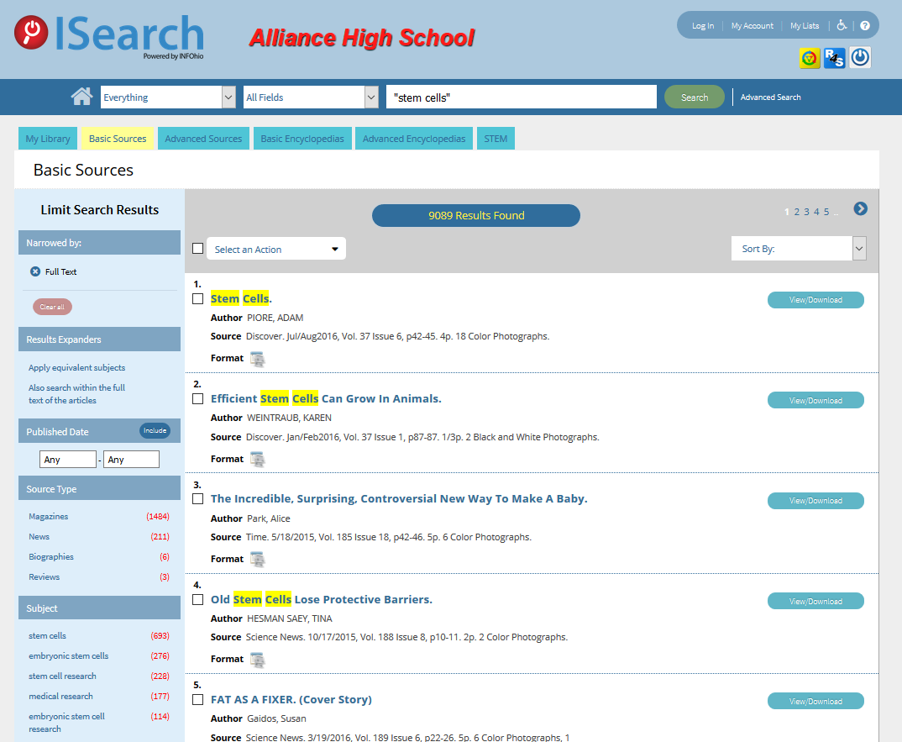
Notes:
Here we are on the basic tab results screen.
Basic: databases at a lower lexile level
Advanced: databases at a higher lexile level
These tabs across the top make it easier for teachers and librarians to differentiate content: Basic tabs for younger students and Advanced tabs for more sophisticated researchers.
Click View/Download to get to the resource in its original environment.

Slide 24
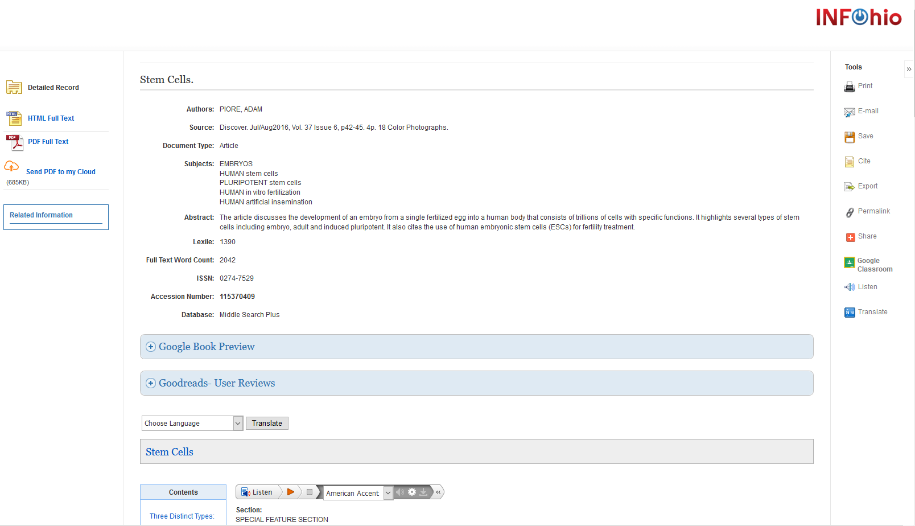
Notes:
Full text,
lexile and word count,
translate,
listen,
print, cite, permalink,
NEW: Save PDF to My Cloud and google classroom upload

Slide 25
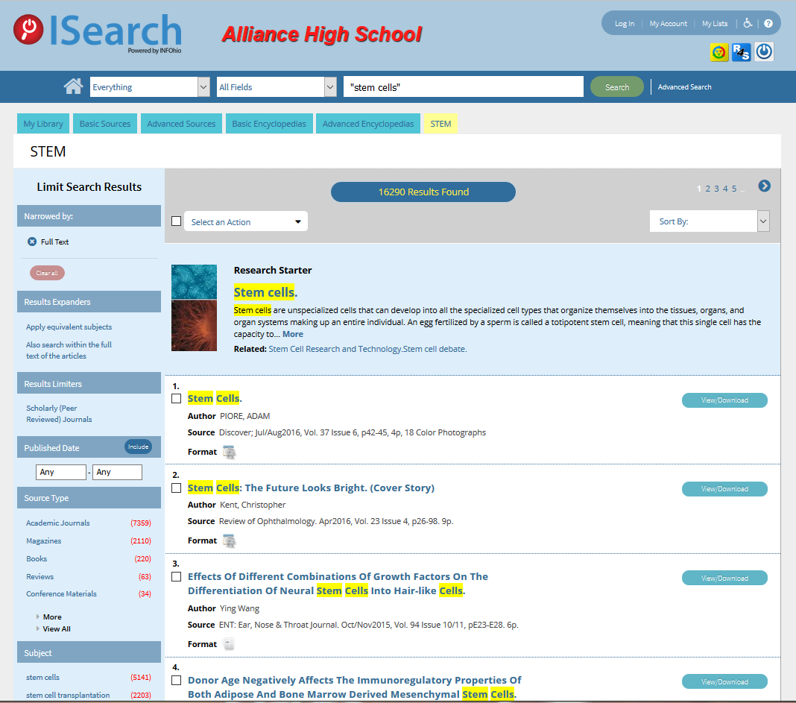
Notes:
NEW: hotlinked titles
Click a hotlinked title…

Slide 26
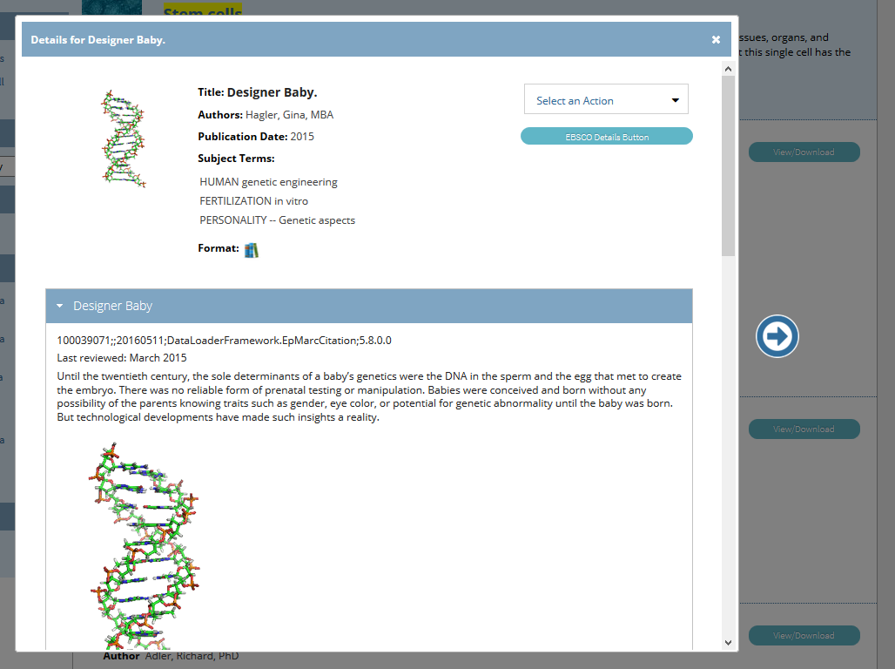
Notes:
And if the item is an HTML full text, the full text comes up right there on the details page, along with images, or in this case—a working animation. I brought this one up and this little DNA rotating.

Slide 27
Notes:
The My Lists feature has also been improved.

Slide 28
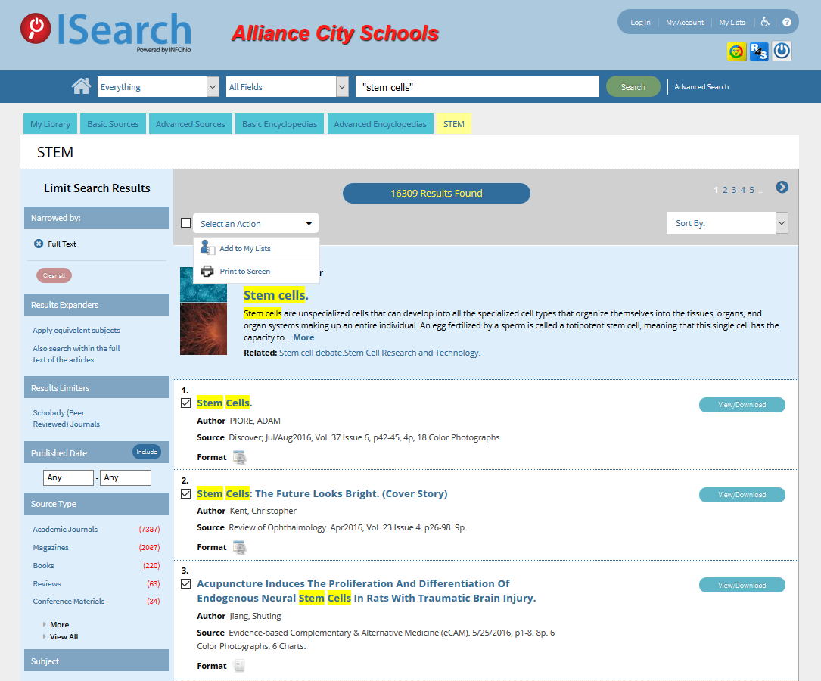
Notes:
Check the items you want to save. Then Click the Select an Action button.

Slide 29
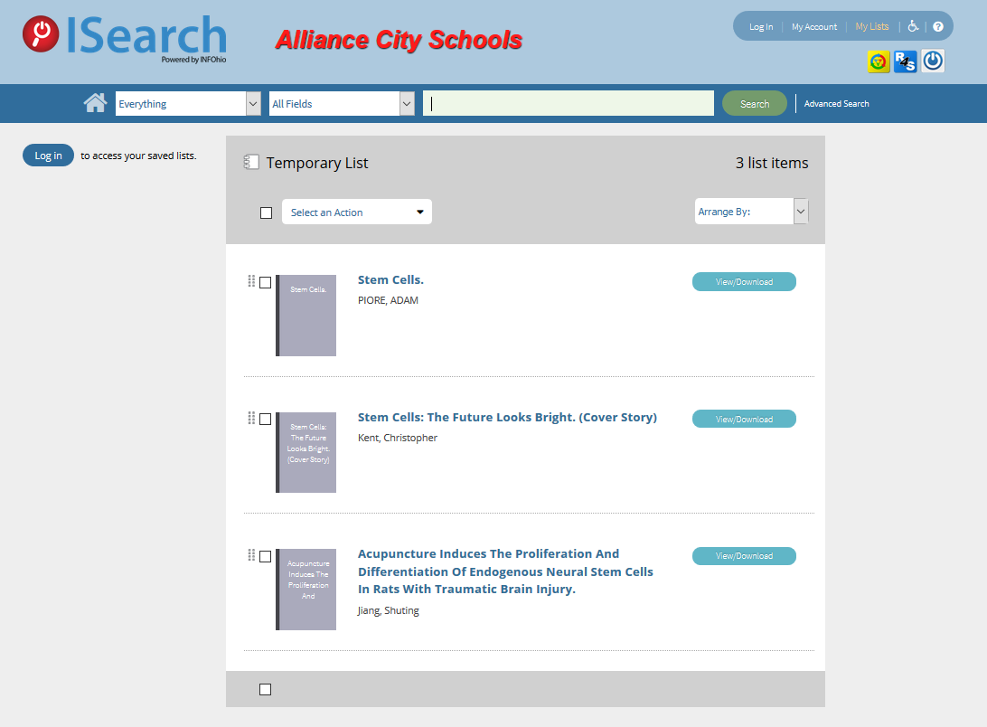
Notes:
When you visit your list, you can either click the View/Download button to get to the article, log in to your library catalog account to SAVE your lists, or choose to print items to the screen.

Slide 30
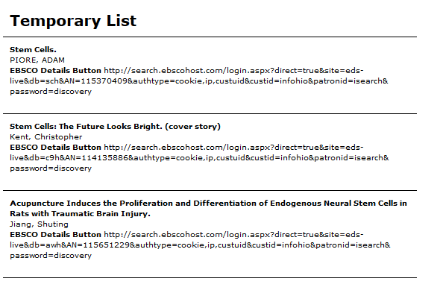
Notes:
If you choose to print to the screen so that you can print or copy and paste into a document, the permalink for articles is now included.

Slide 31
Notes:
Now that you can log in and save lists, students don’t have to maintain separate World Book folders and EBSCO folders and Science Online folders. They can save those materials in the same place they save school library books they want to check out.

Slide 32
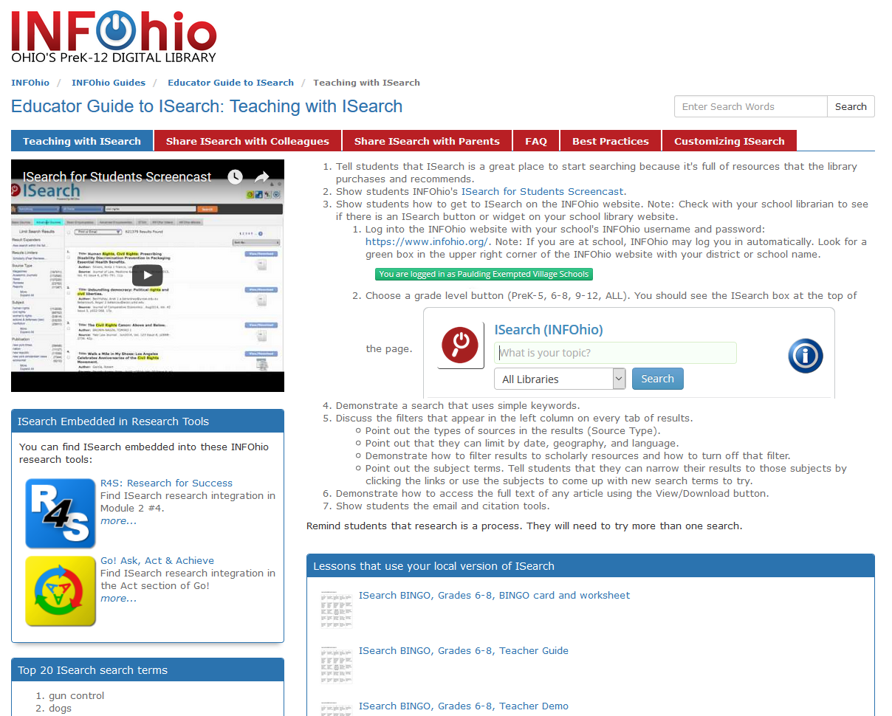
libguides.infohio.org/isearch
Notes:
INFOhio created a new guide to help educators use ISearch in the classroom. It includes assignments that were created or refined by INFOhio Users Council members. Librarians should check out the tab for Customizing ISearch. It can help you create a button or widget to your school’s version of ISearch that you can add to your school library website or your learning management system.
And there’s a tab there with strategies for sharing ISearch with your fellow teachers.

Slide 33
ISearch FAQs
Problem deleting My Lists
Call number not showing on My Lists (ISearch, ISearch2)
Permalinks on ISearch and ISearch2
Call Number displaying incorrect for my library
ChiliFresh Reviews
AR facets
eBook collections
Notes:
ISearch
Problem with deleting my list, does it still exist?
Call number not showing on My Lists on ISearch and ISearch2
* Permalinks on ISearch and ISearch2 - basecamp - configuration issue that needs to be addressed
* Call Number - currently displaying first call number on bib even if titles are filtered by library. We "learned" this after configurations had begun. There is a way around this, but it is a configuration selection that is unique per profile. We have been addressing this on an as reported basis since it is not ubiquitous that HS and ES titles are alike. We did not think it warranted a manual configuration update for all profiles.
* ChiliFresh - is handled through an API key and some special processing. We will circle around to this after initial deployment. It *does* work as can be seen in one of our pilot schools.
* AR facets - will start working on this after initial deployment. I am thinking of two new facets - AR or RC or anything else - and reading level. May call upon users council to review initial startup.
* eBook collections - moving from "pilot" to "production"; setup gutenberg through eRC

