Slide 1
Infographics & Your Library
Library Infographics?
Creating visual, sometimes supported by text – to represent information or data with the aim of educating an audience about your library
Annual Library Report
Easelly Example
Pinterest
Monthly Circ Counts – WorkFlows
Promote Library / Library Statistics – WorkFlows Handbook – Promote Library & Statistics Section
INFOhio Data This includes BookFlix/INFOhio Website Logins/ISearch Local/Storia
Circulation Statistics – November December January

Slide 2
Possible Infographic Template Categories/Sections:
New this Year
Databases, eBooks, etc.
Statistics
Circulation (checkouts, average checkouts per student per year, circulation by item groups)
Population (total student/staff, total library visits)
Collection (weeded, new, donation, totals by item group)
Collaboration
Special programs
Teacher collaboration
Quotes
From Student/staff
Various Duties (time spent)
Communication
Curriculum support
Support of institution
Library staff support (volunteers, clerical)
Assist teachers
Library management
Goals
Next year's goals

Slide 3
Statistic Reports for Your Annual Report - WorkFlows
Circulation
Total Checkouts by Item Group
Total Checkouts by Grade
Total In-House Checkouts
Popular Items (Highest circulation items)
Population
Total Patrons Served
Collection
Shelf List (shows item status totals, item group totals, total items in library)
Total Items by Funding Source for Year
Total Value of Collection
Total Age of Collection
List of New Titles for the Year (and Total Cost)
Total Receipts by Payment Type

Slide 4
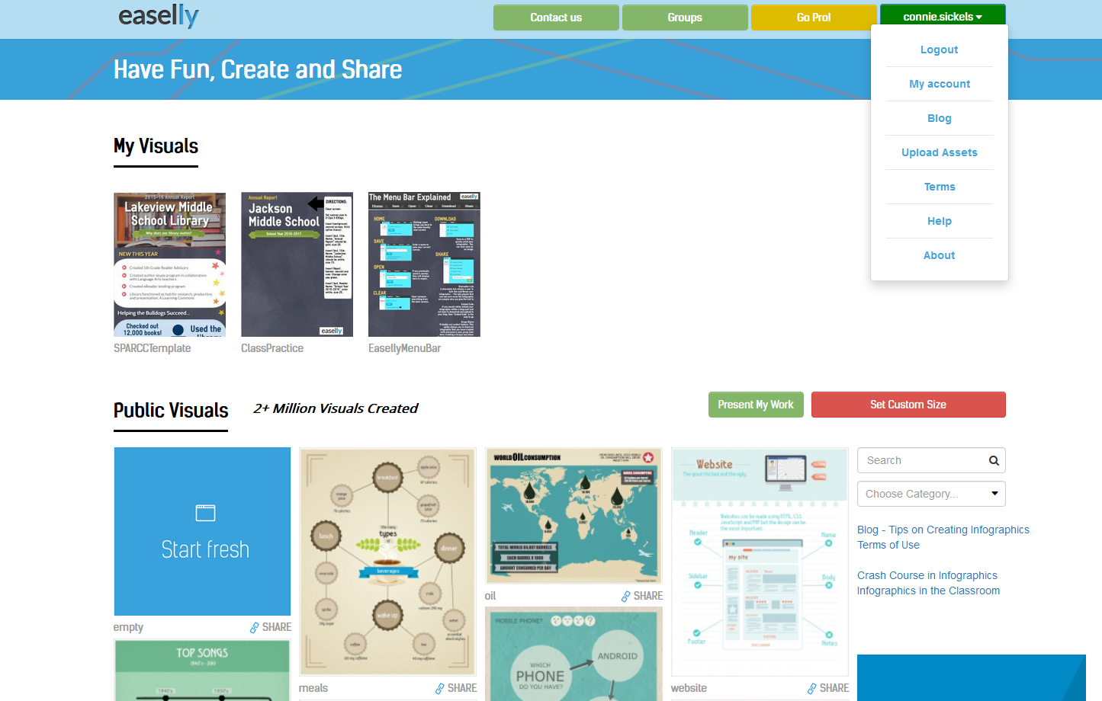
Homework for February Meeting
Create your own free Easel.ly account
https://www.easel.ly/
Review the “HELP” section
Compile the information you need! Stats from WorkFlows!
Bring your own device to Feb meeting capable of using Easel.ly.

