Slide 1
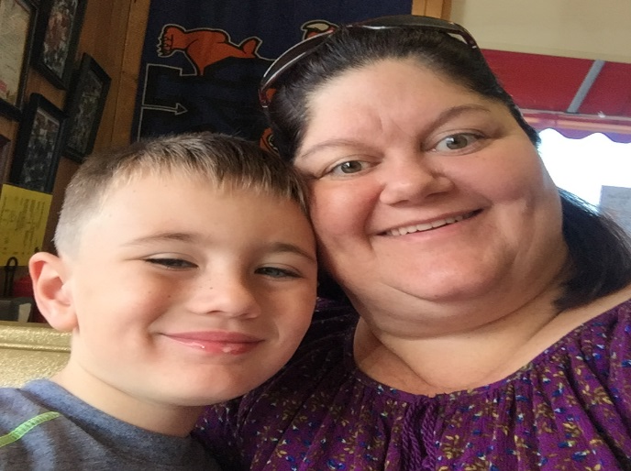
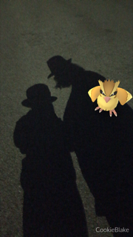
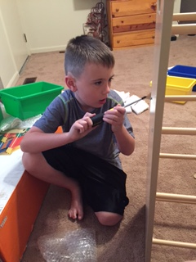
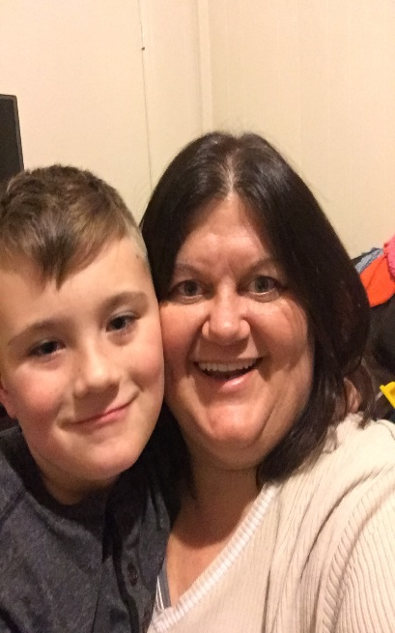
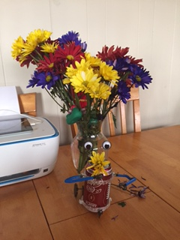
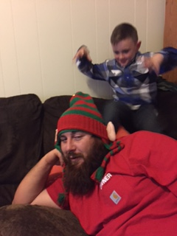
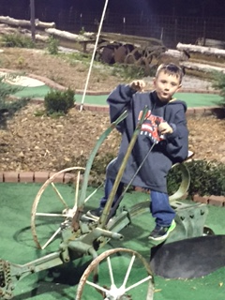
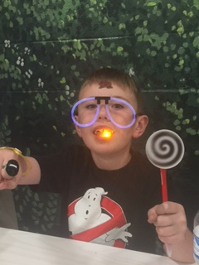
SPARCC INFOhio Users Meeting December 9, 2016

Slide 2
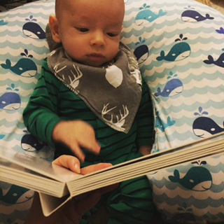
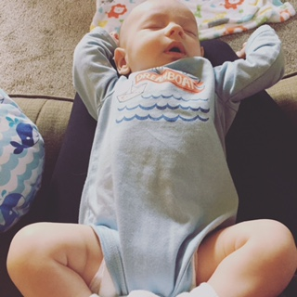
Update on RJ – 3 months!

Slide 3
Welcome!
Special Vendor: Andrea Eshelman
Education Consultant K-12 for Gale, A Centage Company
Special Guest: Theresa Fredericka
Executive Director of INFOhio

Slide 4
Thank you SPARCC for Your Advocacy !
Notes:
On our new Advocacy page, you’ll find an easy way to contact your legislators plus Topic Starters to help you write a short email to let them know how #INFOhioWorks for your school!

Slide 5
#SPARCC Libraries WORK!
November Statistics!
Check-Ins: 121,659
Check-Outs:117,420
Renewals: 11,344
In House Checkouts: 513
Grand Total Transactions: 250,936!!!!!!!!!!

Slide 6
Infographics & Your Library
Library Infographics?
Creating visual, sometimes supported by text – to represent information or data with the aim of educating an audience about your library
Annual Library Report
Easelly Example
Pinterest
Work Group Time? Feb 3rd / May 5th

Slide 7
Possible Infographic Template Categories/Sections:
New this Year
Databases, eBooks, etc.
Statistics
Circulation (checkouts, average checkouts per student per year, circulation by item groups)
Population (total student/staff, total library visits)
Collection (weeded, new, donation, totals by item group)
Collaboration
Special programs
Teacher collaboration
Quotes
From Student/staff
Various Duties (time spent)
Communication
Curriculum support
Support of institution
Library staff support (volunteers, clerical)
Assist teachers
Library management
Goals
Next year's goals

Slide 8
Statistic Reports for Your Annual Report - WorkFlows
Circulation
Total Checkouts by Item Group
Total Checkouts by Grade
Total In-House Checkouts
Popular Items (Highest circulation items)
Population
Total Patrons Served
Collection
Shelf List (shows item status totals, item group totals, total items in library)
Total Items by Funding Source for Year
Total Value of Collection
Total Age of Collection
List of New Titles for the Year (and Total Cost)
Total Receipts by Payment Type

Slide 9
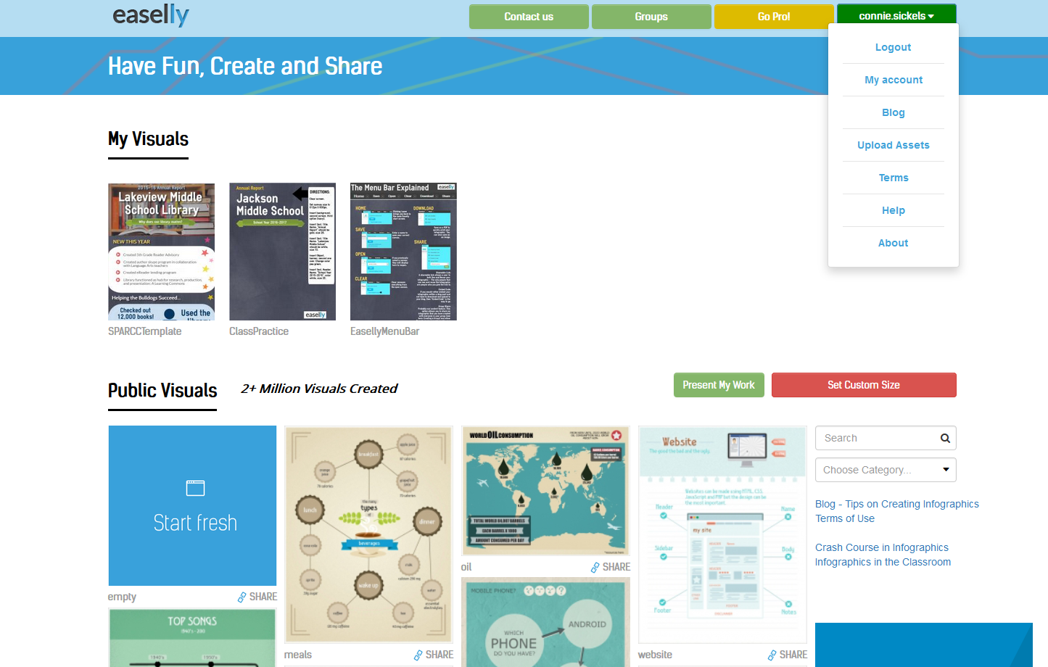
Homework for February Meeting
Create your own free Easel.ly account
https://www.easel.ly/
Review the “HELP” section
Compile the information you need! Stats!
Bring your own device to Feb meeting capable of using Easel.ly.

Slide 10
Housekeeping / Announcements
Vendor Loads – All Complete!
Reminder: Send to Cherwell HD for all vendor loads except for Follett
Email: sparcc_infohio@email.sparcc.org
Patron Photos – All Loaded!
Reminder: Photos are original / not retakes
Ability to change in WF

Slide 11
WorkFlows!
Weeded Items are now Shadowed in Catalog – Did you even notice?
Snow Day? Assembly? Need to change the due date for students?
Create HD ticket – Need info: What day due, new due date

Slide 12
MLA 8 questions
Checking with each of the content providers for their plans to update to MLA 8
INFOhio Citation Guide
Notes:
In April 2016, MLA (Modern Lang Associ) replaced its seventh edition resources with a new eighth edition. This updated version reflects the ways in which digital publication has changed how writers and researchers document sources.

Slide 14
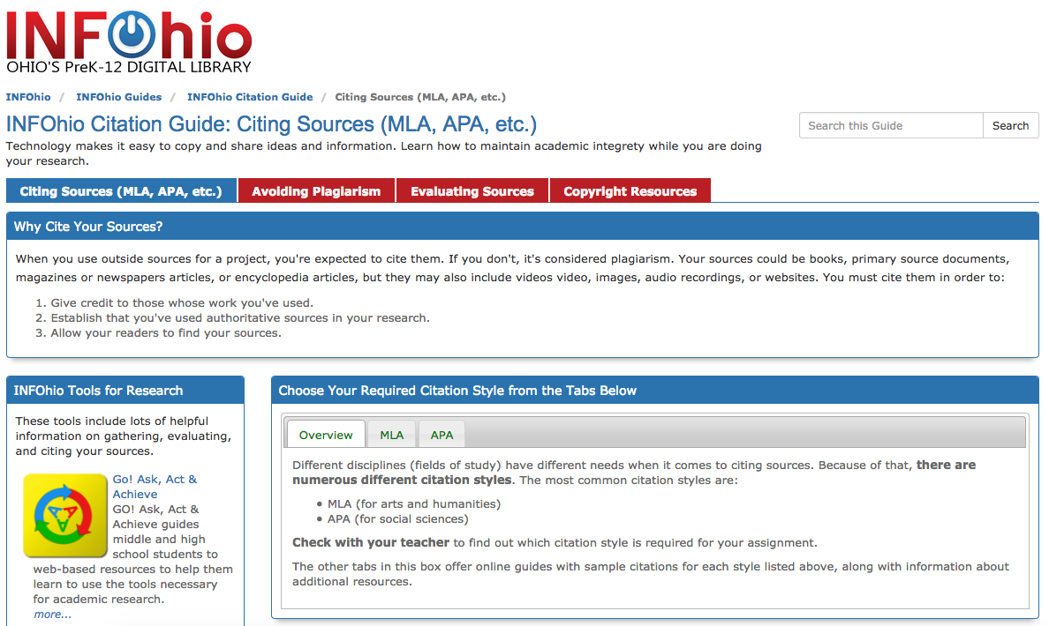

Slide 15
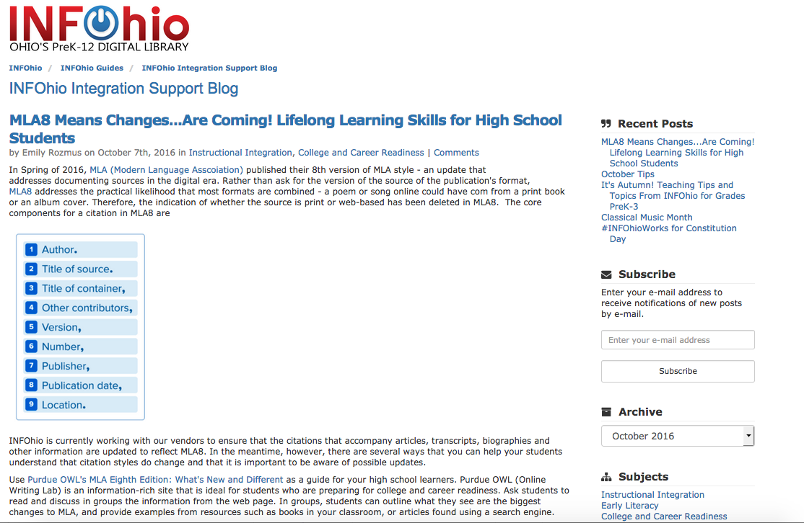

Slide 16
Improved Process for Requesting Storia Access
https://www.infohio.org/requeststoriaaccess
Provides immediate response via email
Checks to see if email address requested access previously
Simplified prompts for additional information

Slide 17
Isearch Update!
Limiter - Building Search
Limiters weren’t working in all districts with the following address: http://isearch4.infohio.org
Quickly fixed!

Slide 18
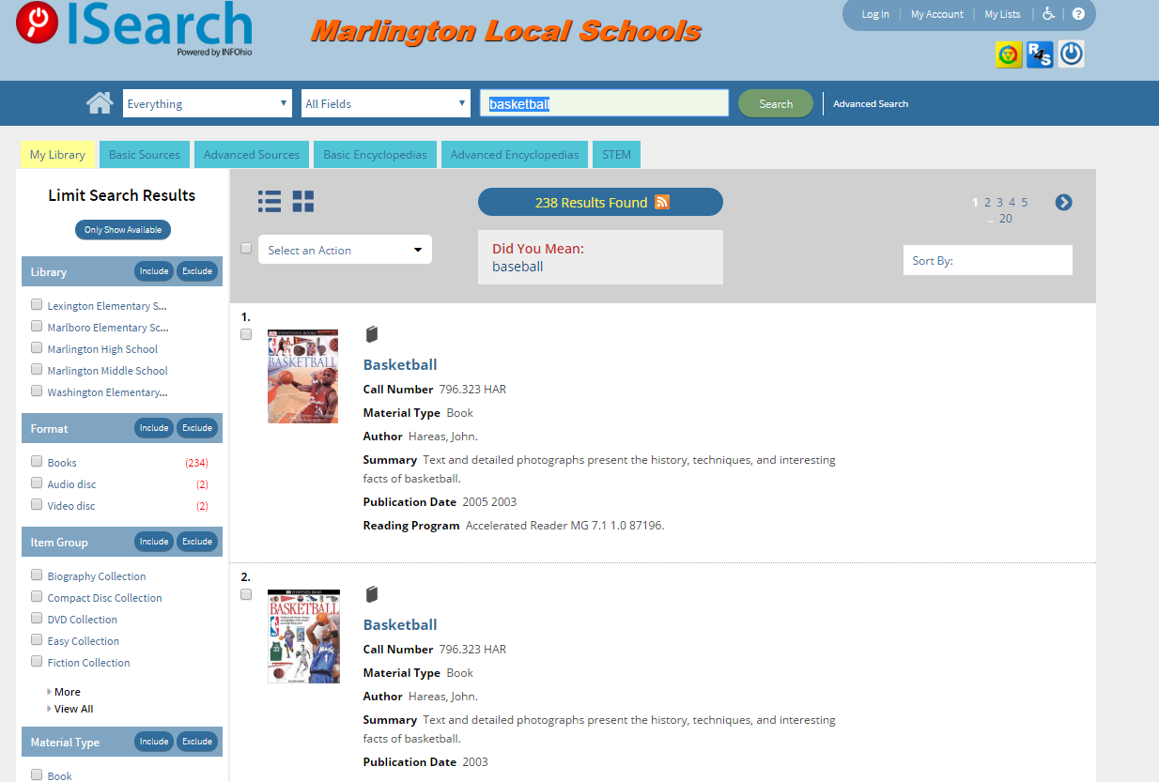

Slide 19
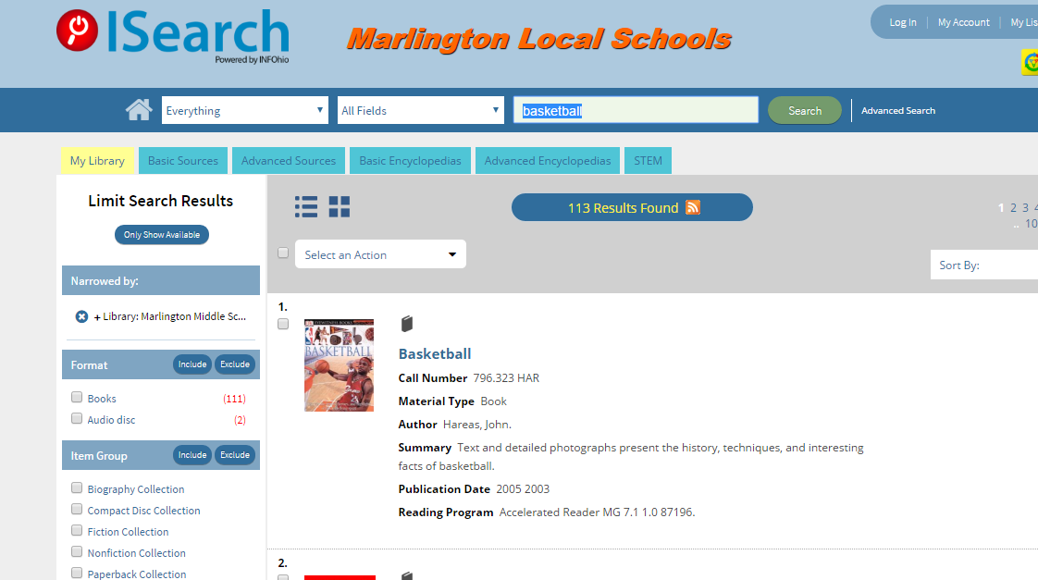

Slide 20
Preferred Call Number
Refers to option to be able to “prefer” one call number over another for display
Especially desirable in multi-library instances where titles are shared between independent libraries
Contains 4 components:
Choosing Preferred Call number source
Displaying copies in un-collapsed list
Adding library-specific “copies available” number
“Hiding” district” total copies available number
Notes:
Another set of concerns that we have heard is that the Call number displaying for a specific library did not below to them, but to another library in their district. Also, the availability did not reflect those items available in “their” library, the but for the whole district. And then when you viewed the items, it was difficult to tell which item you were choosing if you wanted to place a hold or do other patron operations.
So after some research, we discovered something called Preferred Call Number which refers to the ability to configure from which library the call number is drawn for display. So this is something that can be configured. Further, if we include a field called Availability, and there is a library search limit, then only the more accurate count for those items from that library will be displayed on the results list. We had also “collapsed” the children (or item records for deduping) but found that was probably not what librarians wanted because it makes it more difficult for students to isolate items and whether they were available or not.
That was all good news. The troubling news was how to make these changes universal:
- Correct wrong call number from other libraries in district (4 fields has to be done once each library in multi-library instances +2000 times)
- Add Availability field on results reflecting just this library's holdings (has to be done 600+ times)
- Itemize copies so holds can be placed on correct copy (has to be done 600+ times)
Hide available number because it is for whole district (has to be done once)
So we are not going to manually making this change statewide, but are asking those that report the “bad” call number, that you open a helpdesk ticket and we will configure those that actually have a call number conflict with other libraries in their district. We *will* be pursuing some customized scripting that will allow for these changes statewide at a future time with SirsiDynix using one of our platinum services.

Slide 21
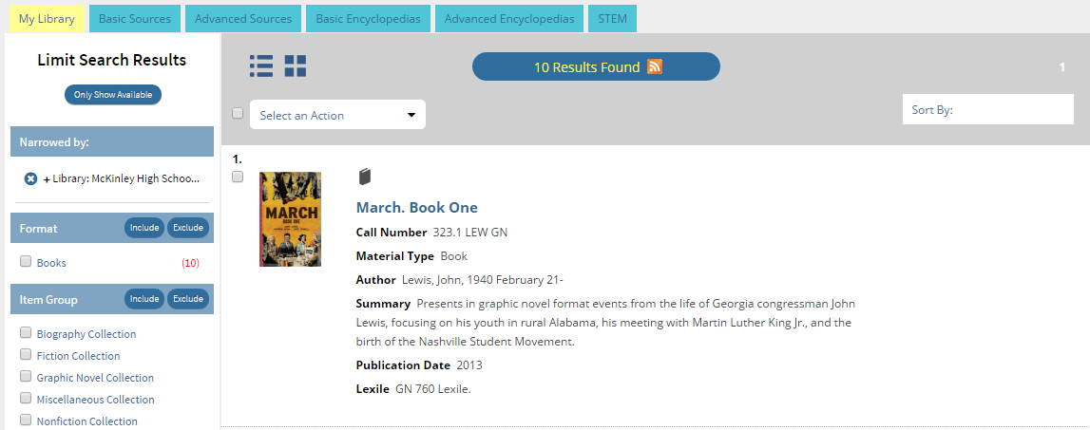

Slide 22
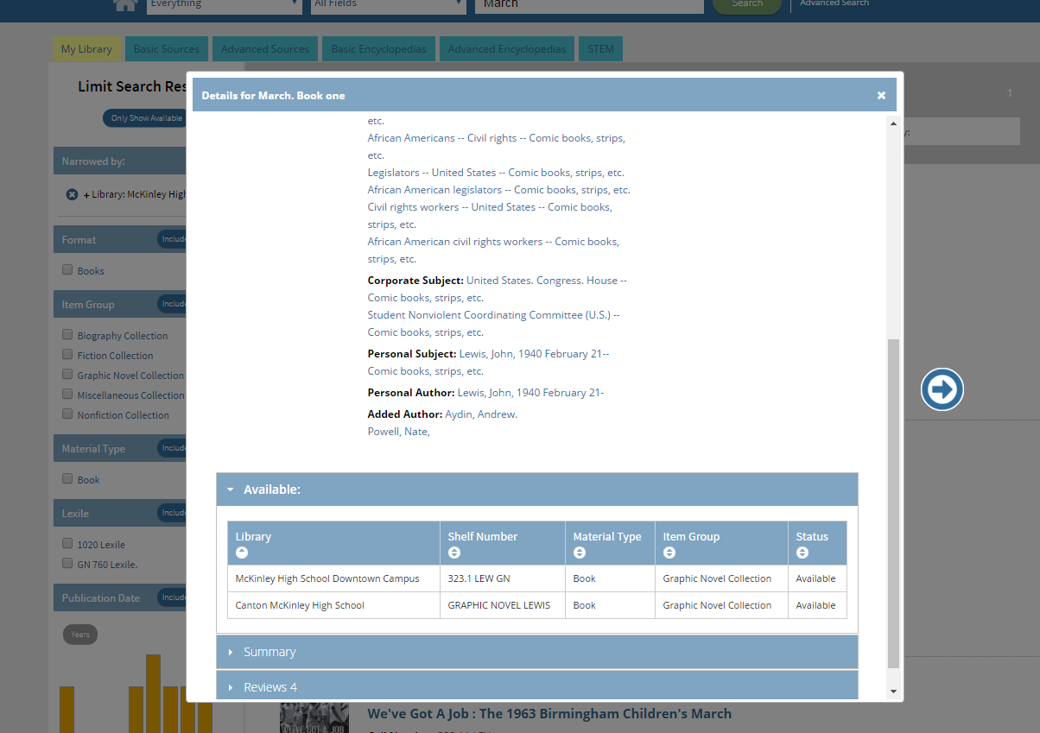

Slide 23
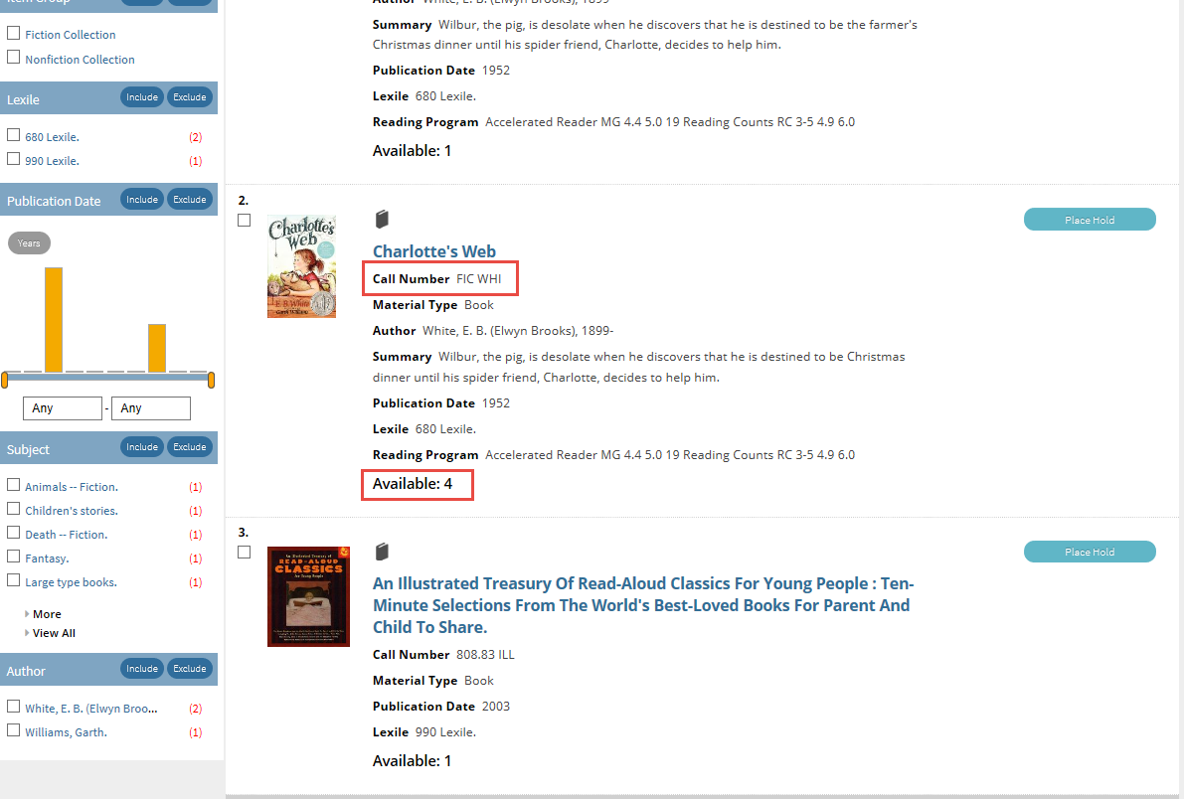
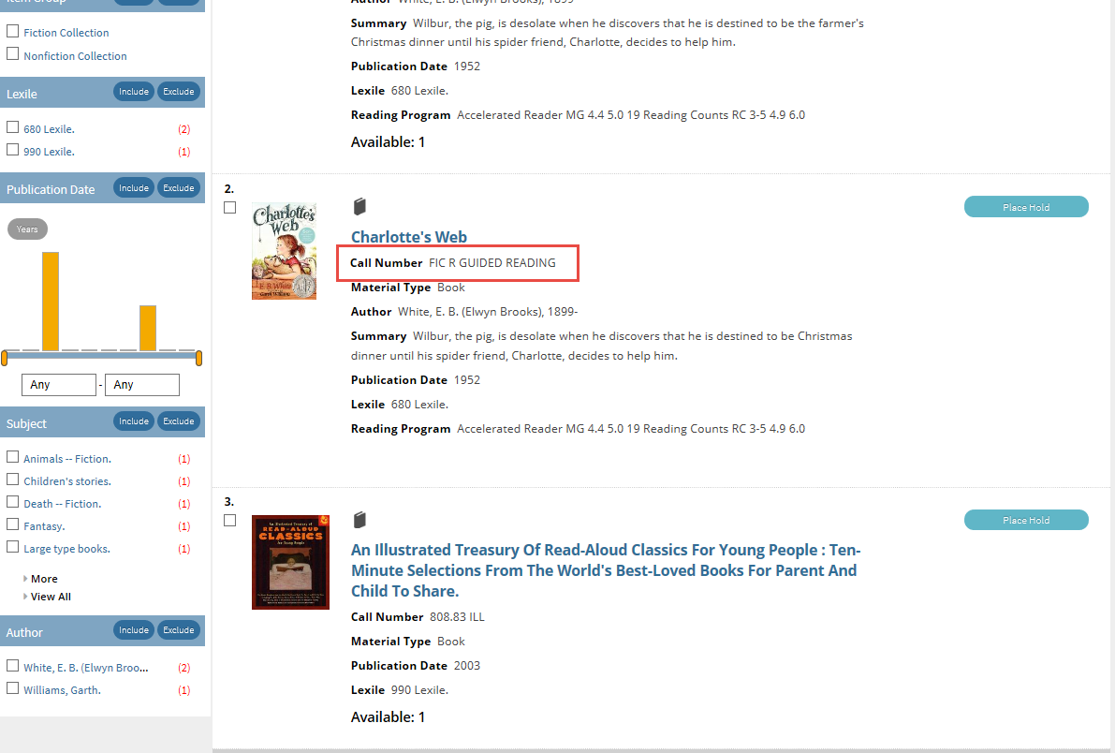
Notes:
Screen shot of results before changes – circle bad call number
Screen shot post changes – circle good call number and available number

Slide 24
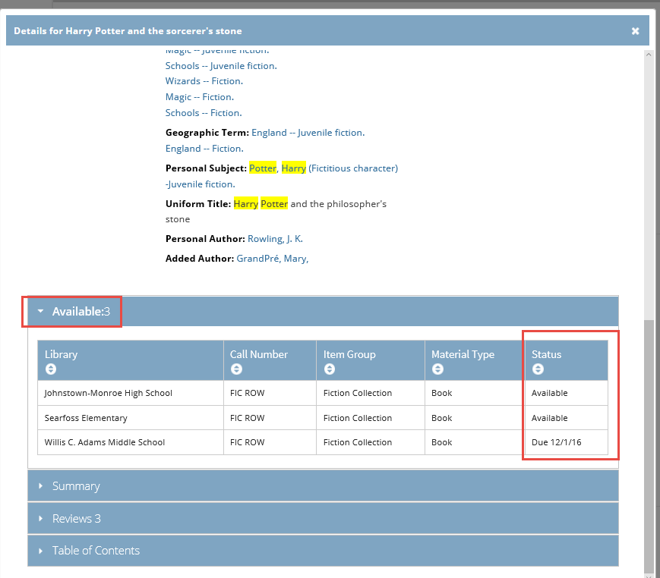
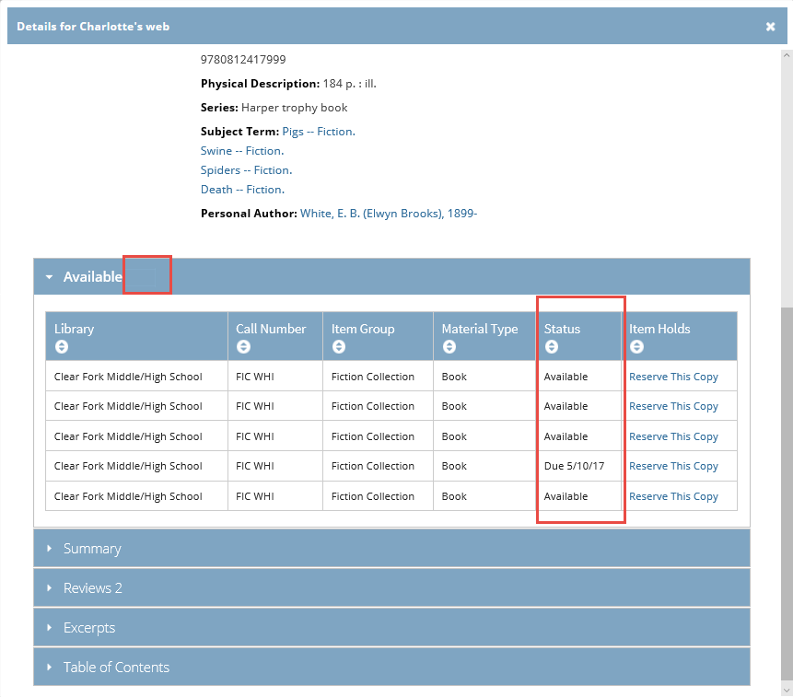
Notes:
Good example title in Johnstown. This detail display lists three libraries and implies that each has 1 copy, but in fact the High School has 2 available copies. The Available number of 3 is representing 2 in the High School and 1 in Searfoss, because the 1 in Adams is not actually available.
This is what Clear Fork looks like now.

Slide 25
ISearch Enhancements
All Libraries button on Banner
ChiliFresh added to those with subscriptions
Add Reading Program limiters and lexile range chart
Notes:
Some additional feedback we’ve gotten, even during the initial pilot was to include an “All Libraries” button in the banner so users could expand their search.
Screenshot of mock up
Add ChiliFresh Reviews (pull the whole of the INFOhio list from ChiliFresh Tech Svcs. And then
1) automatically update those
2) wait for a request from them (we’ve already received 1 or 2)
3) Get you the list and let you check with libraries individually
Screenshot of Hudson
Add Reading Program limiter (difficult; multi-steps each 600 times) and lexile range chart. This came from UC and will take more work. It is not likely to appear this school year.
Screenshot of mock up

Slide 26
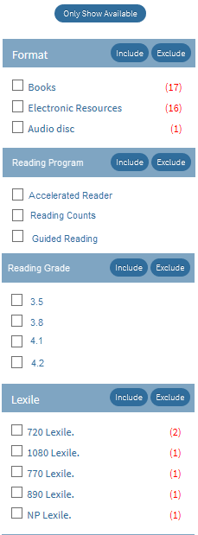
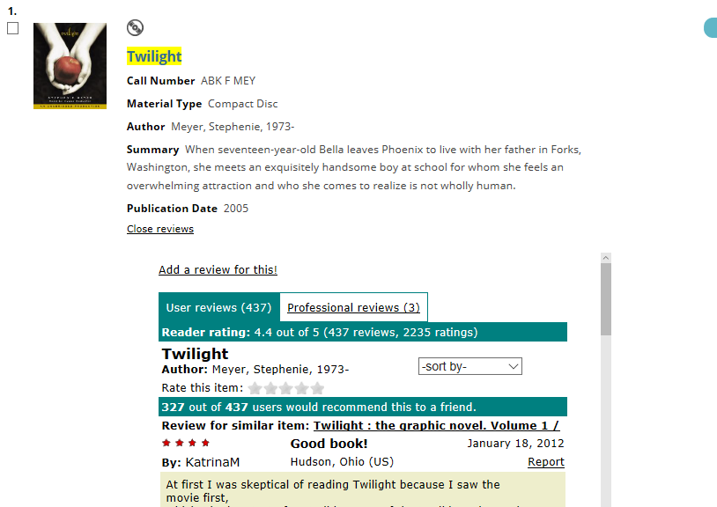
Notes:
Mockup All Libraries link on banner
Screenshot of Hudson ChiliFresh
Mock up Reading Program limiters for Program and for Grade Levell

Slide 27
ISearch Summary
Work in process
Book Rivers Customization
“No results” page
Preferred Call Number
Waiting in the wings
All Libraries button
ChiliFresh
Reading program and others
Next major component
Project Gutenberg
Library eBook subscriptions

Slide 28
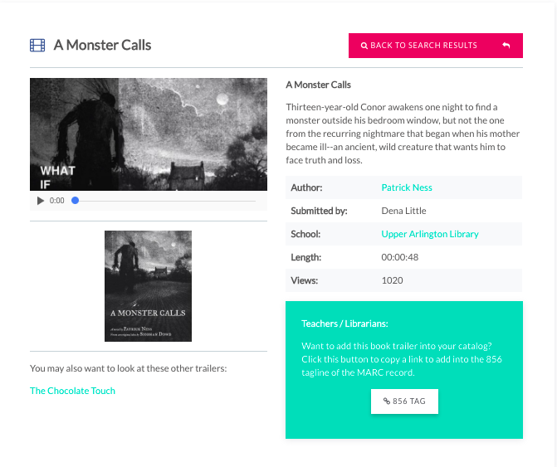
Notes:
Most trailers have a recommended viewing list of other trailers that might be similar to the current trailer you are viewing. Also, librarians can add the URL to a specific trailer to their MARC record in the 856 field by clicking on the 856 tag button as shown here. Coming soon: a video tutorial that shows how to add the link and what it looks like in the OPAC.

Slide 29
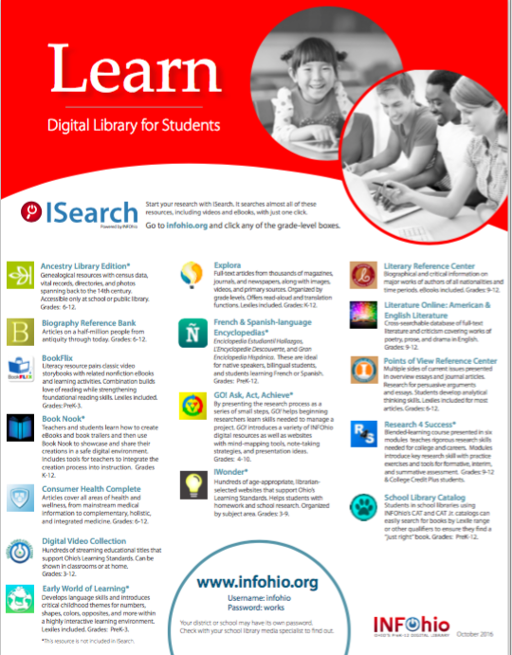
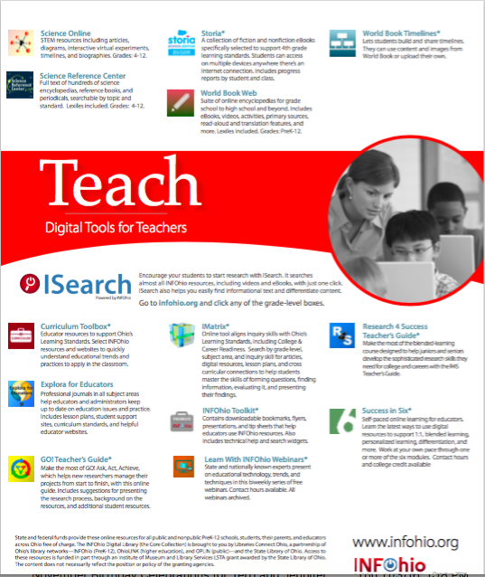
Back by Popular Demand

Slide 30
oetc.ohio.gov
February 14 – Preconferences-
Developing Data Visualization Skills to Demonstrate Value and Make Informed Decisions in Education Using Tableau
Control/Alt/Read: Reading Digital Text in the Plugged In Classroom of the 21st Century
February 15 & 16 – Many INFOhio sessions!
Stop by the INFOhio booth – 722/724

Slide 31
Questions?

